Slide 1
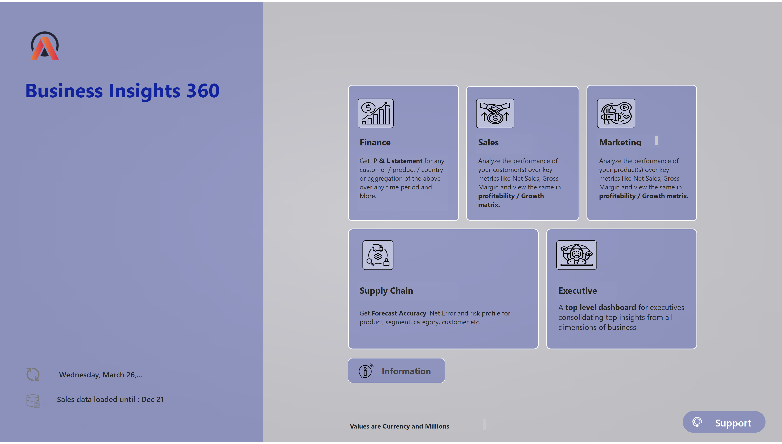
Home
Notes:
image
No alt text provided
image
No alt text provided
image
No alt text provided
image
No alt text provided
image
No alt text provided
image
No alt text provided
textbox
No alt text provided
textbox
No alt text provided
textbox
No alt text provided
textbox
No alt text provided
textbox
No alt text provided
textbox
No alt text provided
textbox
No alt text provided
textbox
No alt text provided
textbox
No alt text provided
textbox
No alt text provided
textbox
No alt text provided
textbox
No alt text provided
actionButton
No alt text provided
Support Button
No alt text provided
cardVisual
No alt text provided
image
No alt text provided
image
No alt text provided
cardVisual
No alt text provided
shape
No alt text provided
actionButton
No alt text provided
shape
No alt text provided
shape
No alt text provided
shape
No alt text provided
shape
No alt text provided
shape
No alt text provided
shape
No alt text provided
shape
No alt text provided
shape
No alt text provided
shape
No alt text provided
shape
No alt text provided
shape
No alt text provided
shape
No alt text provided
shape
No alt text provided
actionButton
No alt text provided
shape
No alt text provided
actionButton
No alt text provided
shape
No alt text provided
shape
No alt text provided
shape
No alt text provided
actionButton
No alt text provided
shape
No alt text provided
shape
No alt text provided
shape
No alt text provided
shape
No alt text provided
shape
No alt text provided
shape
No alt text provided
actionButton
No alt text provided
shape
No alt text provided
actionButton
No alt text provided
actionButton
No alt text provided
shape
No alt text provided
shape
No alt text provided
actionButton
No alt text provided
actionButton
No alt text provided
actionButton
No alt text provided
actionButton
No alt text provided
image
No alt text provided
actionButton
No alt text provided
actionButton
No alt text provided
actionButton
No alt text provided
actionButton
No alt text provided
actionButton
No alt text provided
shape
No alt text provided
actionButton
No alt text provided

Slide 2
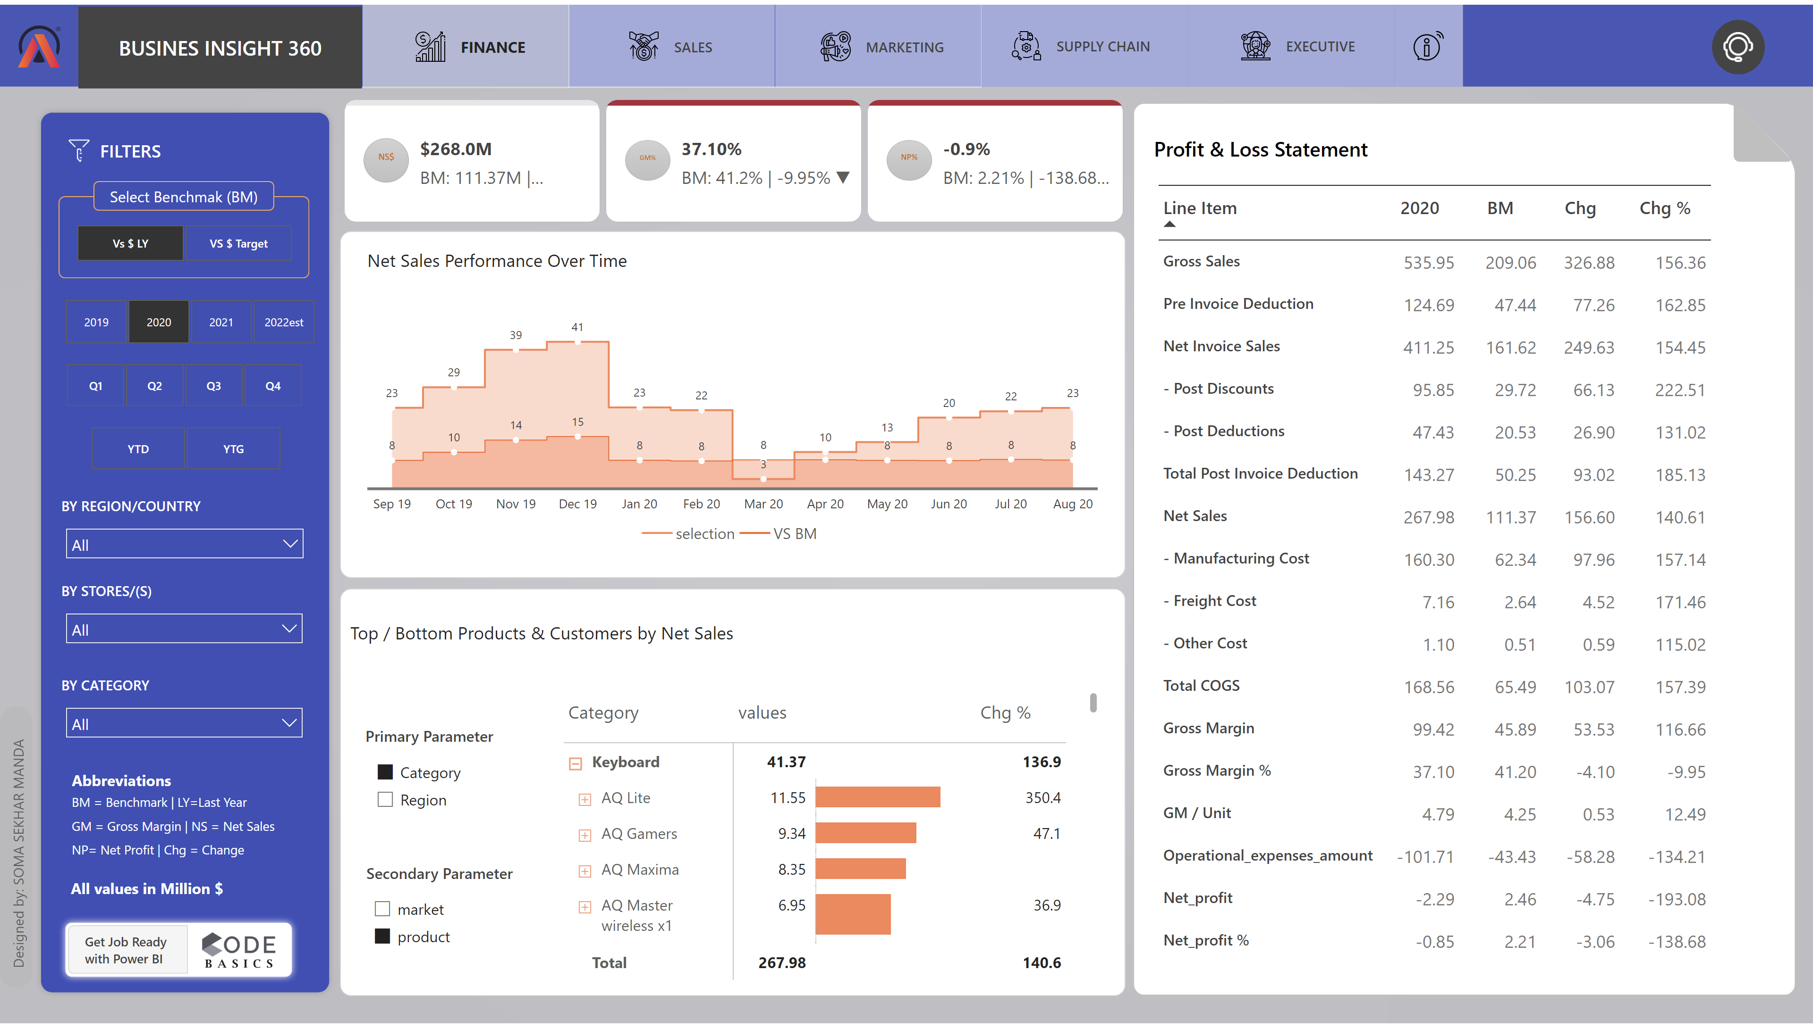
Finance
Notes:
areaChart
No alt text provided
shape
No alt text provided
shape
No alt text provided
pivotTable
No alt text provided
Net Sales
No alt text provided
pivotTable
No alt text provided
image
No alt text provided
AB Signature
No alt text provided
shape
No alt text provided
textbox
No alt text provided
textbox
No alt text provided
slicer
No alt text provided
slicer
No alt text provided
slicer
No alt text provided
slicer
No alt text provided
slicer
No alt text provided
BY REGION/COUNTRY
No alt text provided
BY CATEGORY
No alt text provided
BY STORES/(S)
No alt text provided
slicer
No alt text provided
shape
No alt text provided
shape
No alt text provided
shape
No alt text provided
shape
No alt text provided
shape
No alt text provided
image
No alt text provided
shape
No alt text provided
shape
No alt text provided
image
No alt text provided
shape
No alt text provided
shape
No alt text provided
shape
No alt text provided
shape
No alt text provided
actionButton
No alt text provided
shape
No alt text provided
actionButton
No alt text provided
actionButton
No alt text provided
shape
No alt text provided
shape
No alt text provided
actionButton
No alt text provided
actionButton
No alt text provided
actionButton
No alt text provided
actionButton
No alt text provided
image
No alt text provided
actionButton
No alt text provided
actionButton
No alt text provided
actionButton
No alt text provided
shape
No alt text provided
actionButton
No alt text provided
shape
No alt text provided
shape
No alt text provided
shape
No alt text provided
shape
No alt text provided
shape
No alt text provided
shape
No alt text provided
shape
No alt text provided
shape
No alt text provided
shape
No alt text provided
shape
No alt text provided
shape
No alt text provided
shape
No alt text provided
shape
No alt text provided
shape
No alt text provided
actionButton
No alt text provided
shape
No alt text provided
shape
No alt text provided
shape
No alt text provided
actionButton
No alt text provided
shape
No alt text provided
shape
No alt text provided
shape
No alt text provided
shape
No alt text provided
shape
No alt text provided
shape
No alt text provided
shape
No alt text provided
actionButton
No alt text provided
image
No alt text provided
actionButton
No alt text provided
actionButton
No alt text provided
actionButton
No alt text provided
actionButton
No alt text provided
shape
No alt text provided
shape
No alt text provided
shape
No alt text provided
shape
No alt text provided
shape
No alt text provided

Slide 3
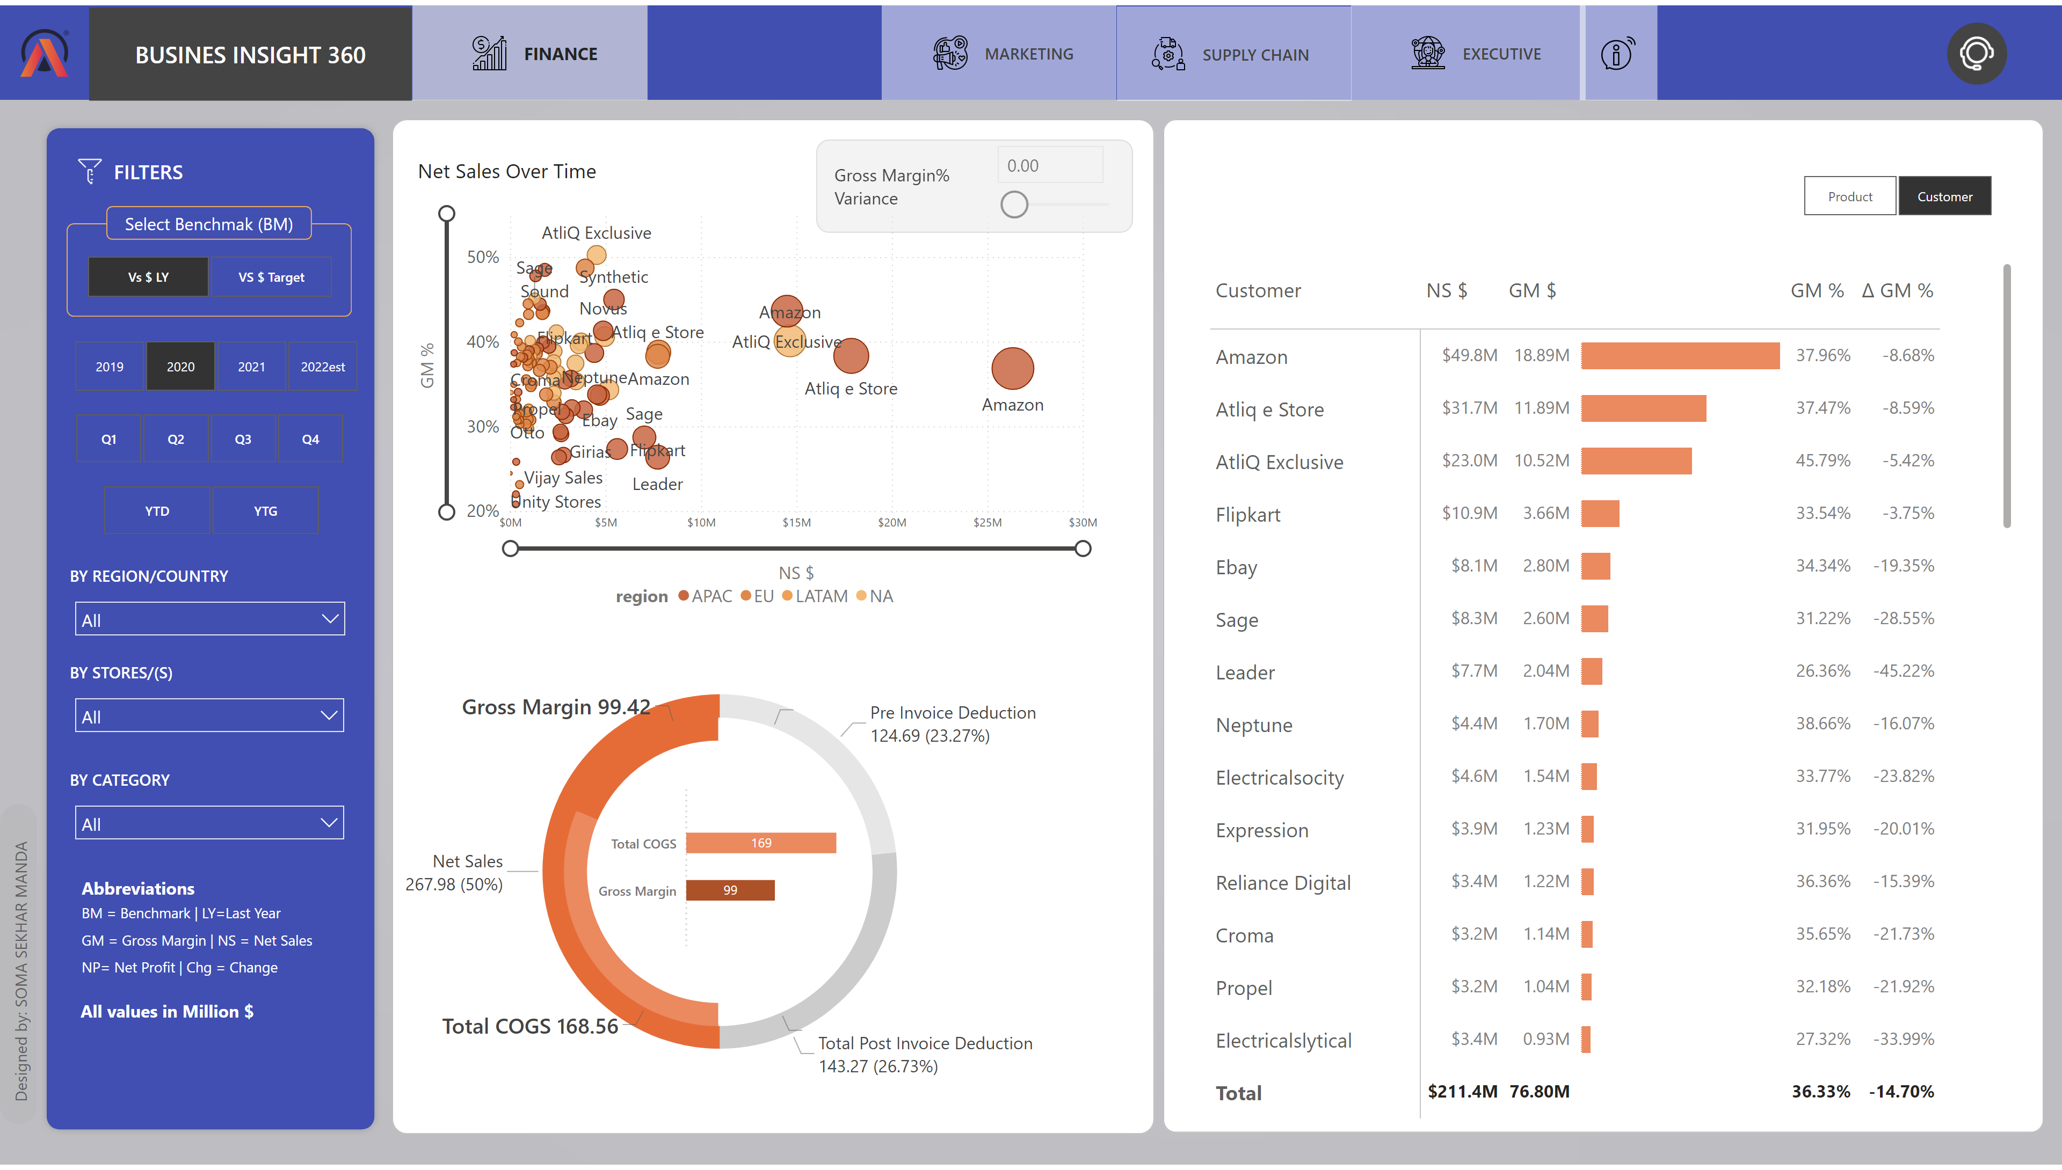
Sales
Notes:
shape
No alt text provided
shape
No alt text provided
shape
No alt text provided
shape
No alt text provided
shape
No alt text provided
actionButton
No alt text provided
actionButton
No alt text provided
actionButton
No alt text provided
actionButton
No alt text provided
actionButton
No alt text provided
actionButton
No alt text provided
shape
No alt text provided
image
No alt text provided
shape
No alt text provided
shape
No alt text provided
shape
No alt text provided
shape
No alt text provided
image
No alt text provided
shape
No alt text provided
shape
No alt text provided
shape
No alt text provided
shape
No alt text provided
shape
No alt text provided
slicer
No alt text provided
BY STORES/(S)
No alt text provided
BY CATEGORY
No alt text provided
BY REGION/COUNTRY
No alt text provided
slicer
No alt text provided
slicer
No alt text provided
slicer
No alt text provided
slicer
No alt text provided
AB Signature
No alt text provided
textbox
No alt text provided
pivotTable
No alt text provided
slicer
No alt text provided
scatterChart
No alt text provided
donutChart
No alt text provided
clusteredBarChart
No alt text provided
donutChart
No alt text provided

Slide 4
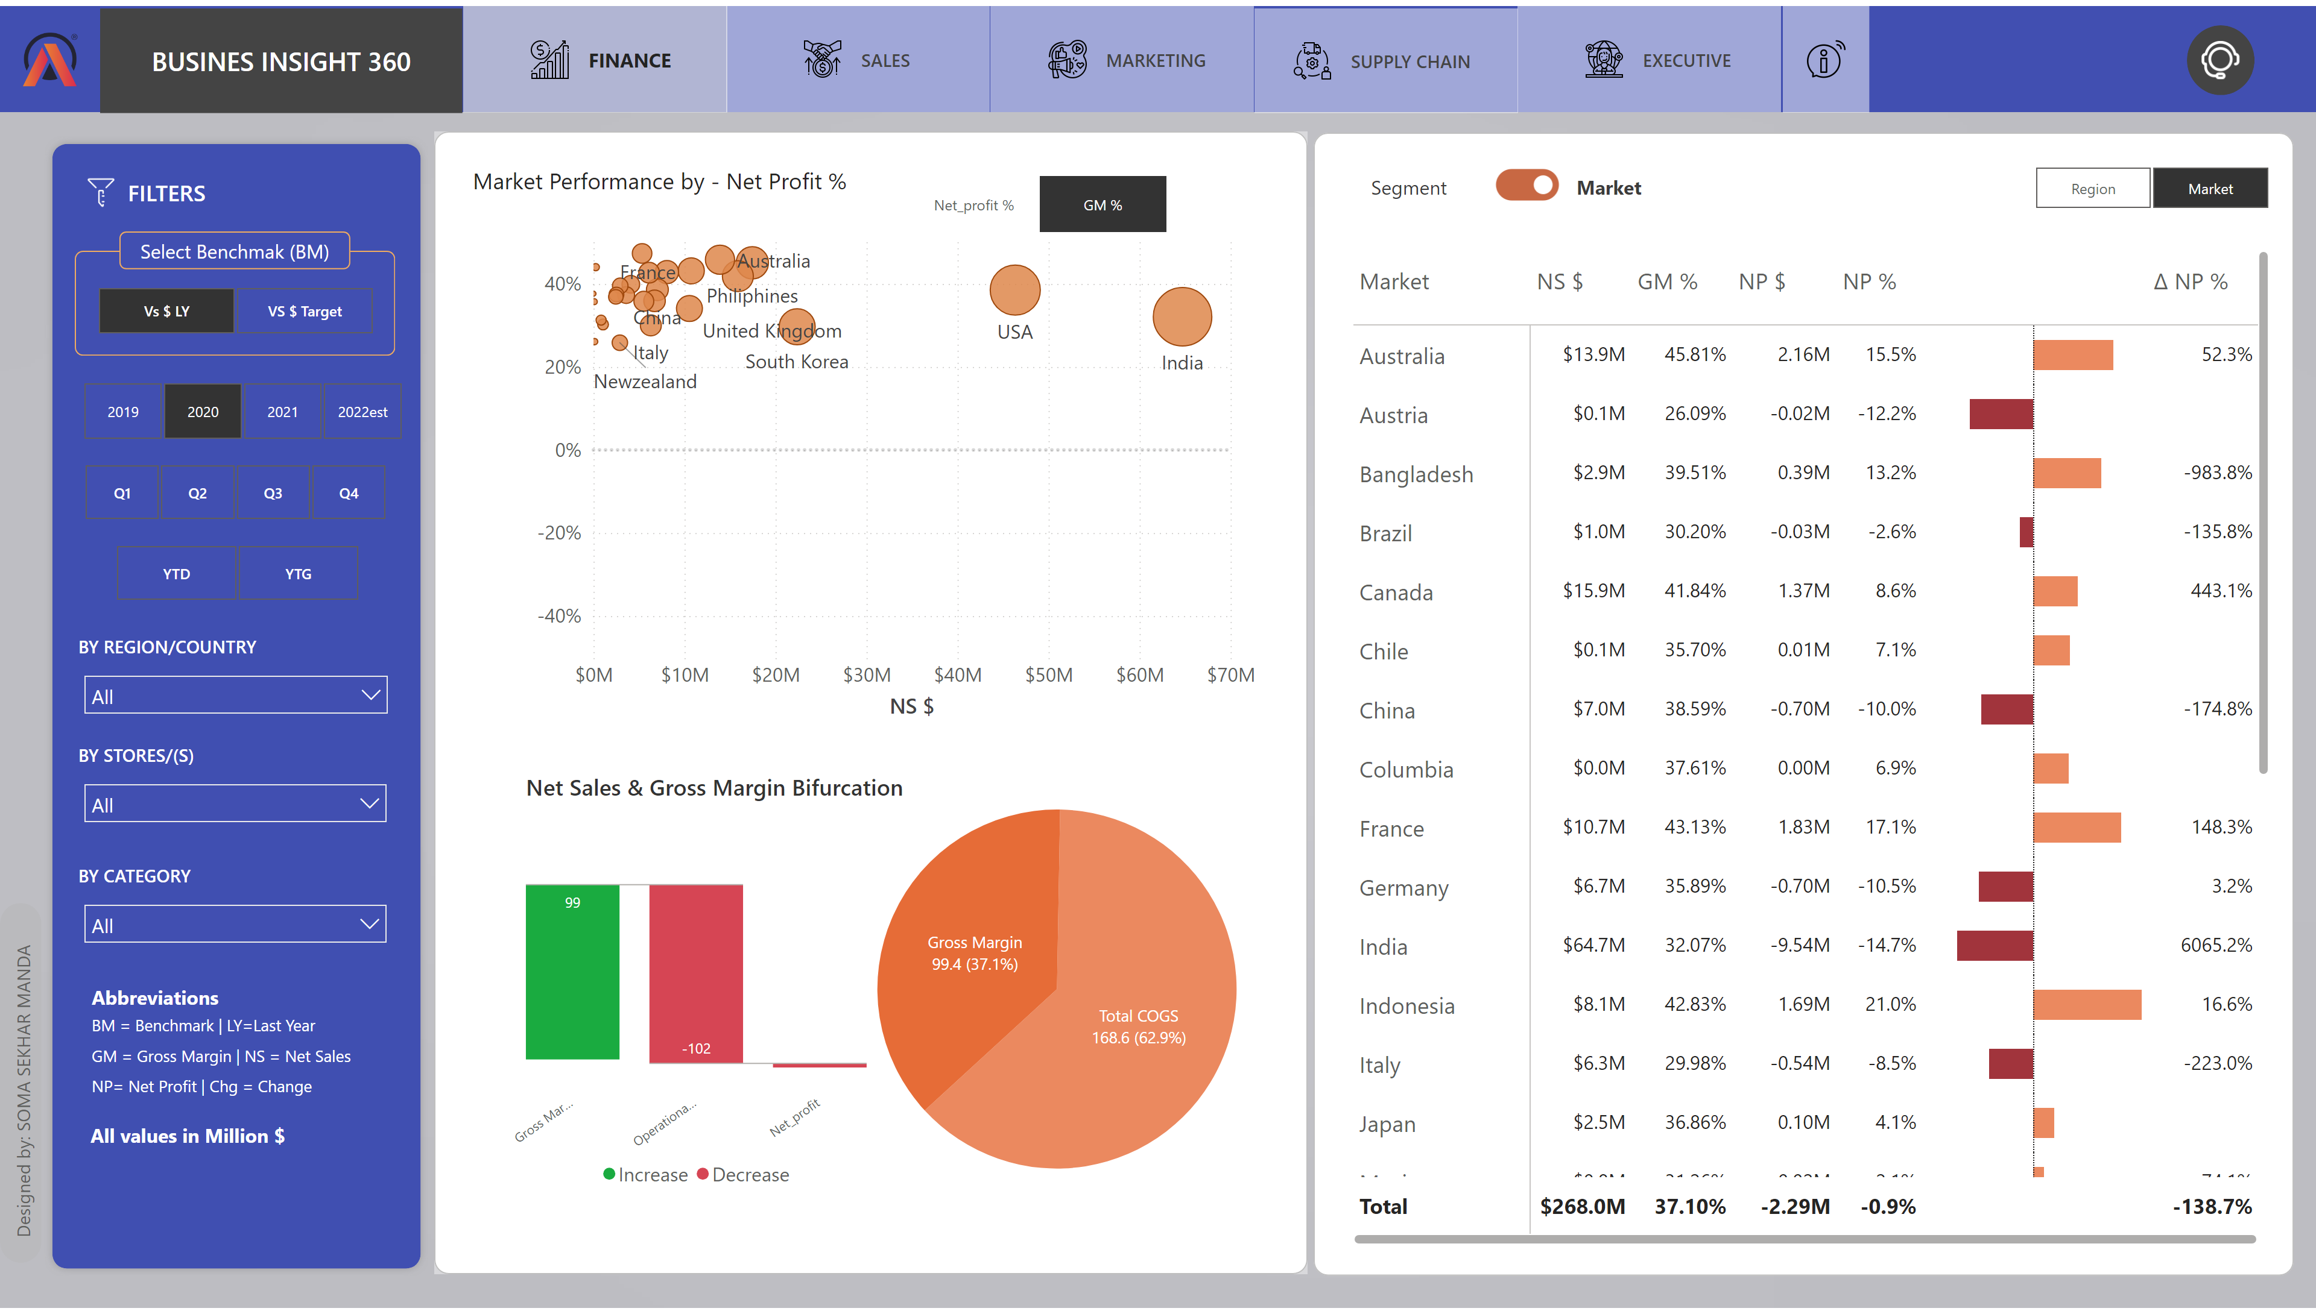
Marketing
Notes:
donutChart
No alt text provided
waterfallChart
No alt text provided
actionButton
No alt text provided
scatterChart
No alt text provided
shape
No alt text provided
AB Signature
No alt text provided
shape
No alt text provided
shape
No alt text provided
pivotTable
No alt text provided
scatterChart
No alt text provided
slicer
No alt text provided
slicer
No alt text provided
textbox
No alt text provided
image
No alt text provided
actionButton
No alt text provided
scatterChart
No alt text provided
actionButton
No alt text provided
scatterChart
No alt text provided
Lbl TopN Normal
No alt text provided
Slicer Market
No alt text provided
Lbl All - selected
No alt text provided
NP %
No alt text provided
Matrix Category
No alt text provided
Slicer button Net Profit
No alt text provided
Toggle Market ON
No alt text provided
net profit tittle
No alt text provided
slicer
No alt text provided
slicer
No alt text provided
slicer
No alt text provided
BY REGION/COUNTRY
No alt text provided
BY CATEGORY
No alt text provided
BY STORES/(S)
No alt text provided
slicer
No alt text provided
shape
No alt text provided
shape
No alt text provided
shape
No alt text provided
shape
No alt text provided
shape
No alt text provided
image
No alt text provided
shape
No alt text provided
shape
No alt text provided
shape
No alt text provided
shape
No alt text provided
image
No alt text provided
shape
No alt text provided
actionButton
No alt text provided
actionButton
No alt text provided
actionButton
No alt text provided
actionButton
No alt text provided
actionButton
No alt text provided
actionButton
No alt text provided
actionButton
No alt text provided
shape
No alt text provided
shape
No alt text provided
shape
No alt text provided

Slide 5
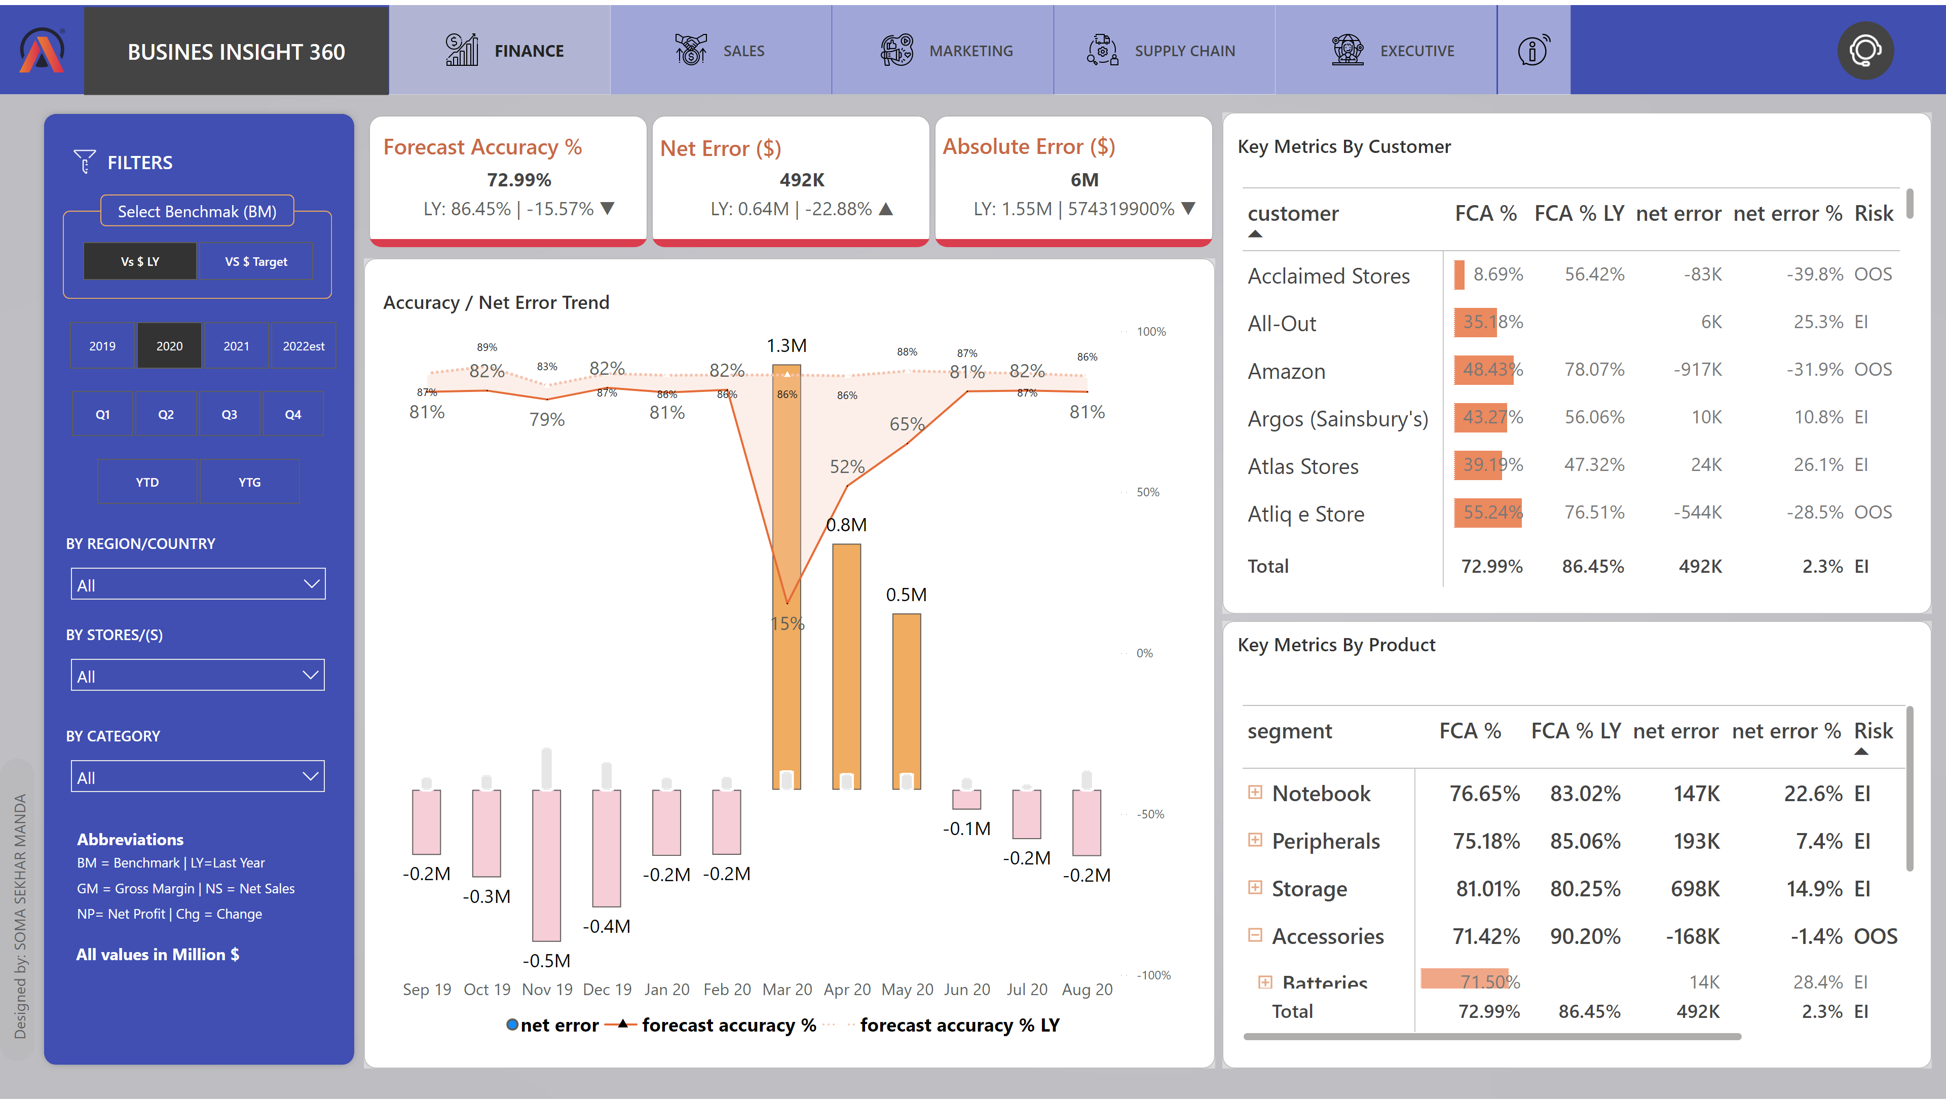
Supply Chain
Notes:
Net Sales
No alt text provided
Net Sales
No alt text provided
shape
No alt text provided
shape
No alt text provided
shape
No alt text provided
pivotTable
No alt text provided
pivotTable
No alt text provided
image
No alt text provided
textbox
No alt text provided
shape
No alt text provided
shape
No alt text provided
shape
No alt text provided
AB Signature
No alt text provided
slicer
No alt text provided
slicer
No alt text provided
slicer
No alt text provided
BY REGION/COUNTRY
No alt text provided
BY CATEGORY
No alt text provided
BY STORES/(S)
No alt text provided
slicer
No alt text provided
shape
No alt text provided
shape
No alt text provided
shape
No alt text provided
shape
No alt text provided
shape
No alt text provided
image
No alt text provided
shape
No alt text provided
shape
No alt text provided
shape
No alt text provided
shape
No alt text provided
image
No alt text provided
shape
No alt text provided
actionButton
No alt text provided
actionButton
No alt text provided
actionButton
No alt text provided
actionButton
No alt text provided
actionButton
No alt text provided
actionButton
No alt text provided
actionButton
No alt text provided
shape
No alt text provided
shape
No alt text provided
shape
No alt text provided
shape
No alt text provided

Slide 6
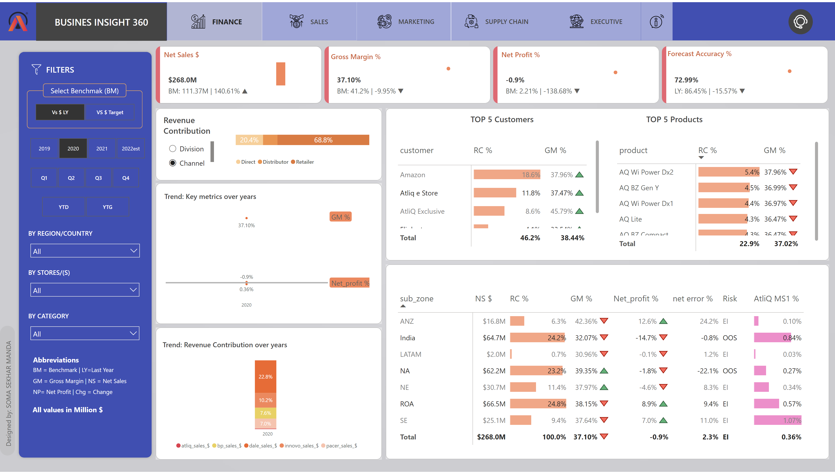
Excutive
Notes:
pivotTable
No alt text provided
ribbonChart
No alt text provided
areaChart
No alt text provided
pivotTable
No alt text provided
pivotTable
No alt text provided
hundredPercentStackedBarChart
No alt text provided
shape
No alt text provided
Net Sales
No alt text provided
areaChart
No alt text provided
areaChart
No alt text provided
areaChart
No alt text provided
clusteredColumnChart
No alt text provided
shape
No alt text provided
shape
No alt text provided
shape
No alt text provided
shape
No alt text provided
shape
No alt text provided
shape
No alt text provided
AB Signature
No alt text provided
slicer
No alt text provided
shape
No alt text provided
shape
No alt text provided
slicer
No alt text provided
slicer
No alt text provided
slicer
No alt text provided
BY REGION/COUNTRY
No alt text provided
BY CATEGORY
No alt text provided
BY STORES/(S)
No alt text provided
slicer
No alt text provided
shape
No alt text provided
shape
No alt text provided
shape
No alt text provided
shape
No alt text provided
shape
No alt text provided
image
No alt text provided
shape
No alt text provided
shape
No alt text provided
shape
No alt text provided
shape
No alt text provided
image
No alt text provided
shape
No alt text provided
actionButton
No alt text provided
actionButton
No alt text provided
actionButton
No alt text provided
actionButton
No alt text provided
actionButton
No alt text provided
actionButton
No alt text provided
actionButton
No alt text provided
shape
No alt text provided
shape
No alt text provided
shape
No alt text provided
shape
No alt text provided
shape
No alt text provided
shape
No alt text provided

